Slide 1
Presentation Order: Used a Random Number Generator
If anyone would like to volunteer to go earlier, that is also fine
Gavin
Caleb Monday, November 28
Nate
Justin
Elizabeth
Parker Wednesday, November 30
Nick
Trenton
Sulaiman
James
Peter
Samantha
Week after Thanksgiving
One more lecture. Any requests? Examples:
More on semiconductors (defects, DOS, p-n junctions)
X-ray absorption spectroscopy (beamline work)
A speaker from NASA offered to come talk to us on Friday of this week. Are we ok with there being a break?

Slide 2
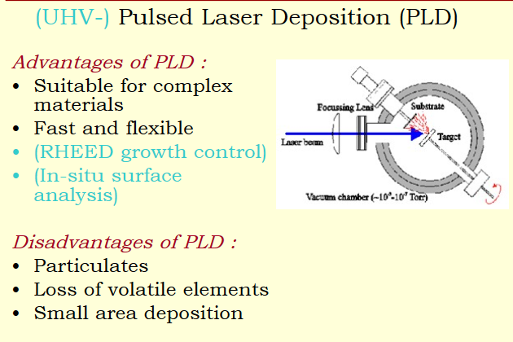
(or Laser)

Slide 3
(or Laser)

Slide 4
(or Laser)
Rotating the target and/or substrate improves uniformity

Slide 5
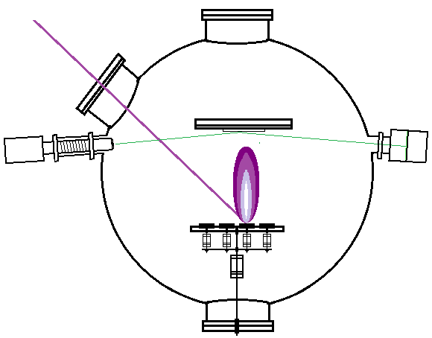
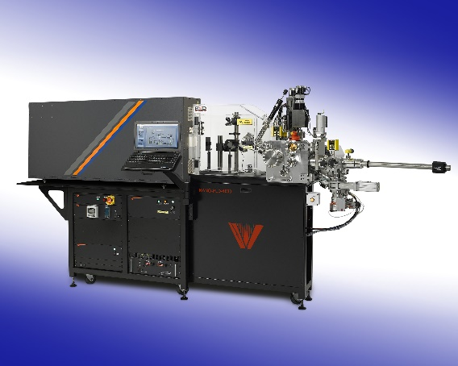
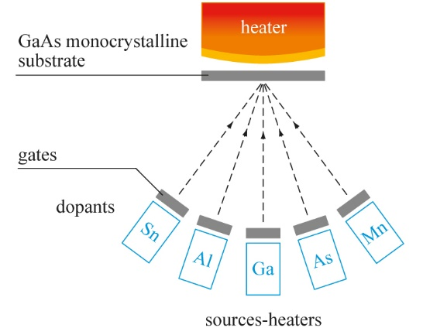
Both MBE and PLD use RHEED to optimize
(Reflection High Energy Electron Diffraction)
Laser (often 248 nm)
Substrate
Electron Detector
Electron Gun
MBE
Target(s)
Laser
Pulsed Laser Deposition (PLD)

Slide 6
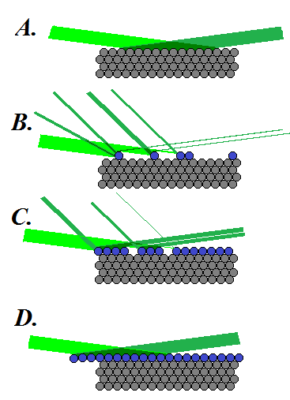
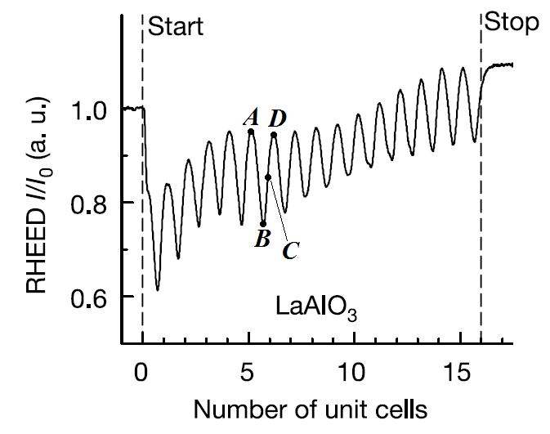
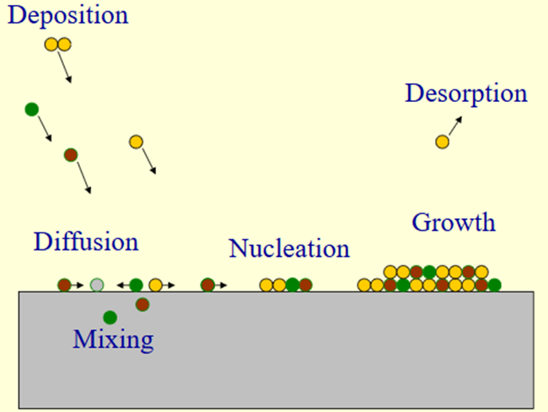
Reflection High Energy Electron Diffraction (RHEED)
Notes:
But the same could be said for making weapons before they were automated.

Slide 7
Reflection High Energy Electron Diffraction (RHEED)
Sample growth with MBE or PLD is sometimes referred to as an art. Every chamber is different. Have to optimize!
Notes:
But the same could be said for making weapons before they were automated.

Slide 8
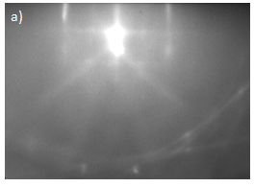
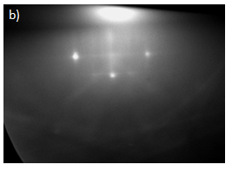
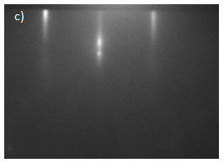
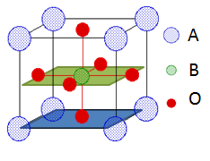
The RHEED Pattern
You actually get a full RHEED pattern, not just an intensity.
a) RHEED pattern of bare TiO₂-terminated SrTiO₃ substrate
b) pattern for a substrate exhibiting mixed terminations
c) LSMO film after deposition was completed.
Most people just monitor the main peak, but there may be value in monitoring other peaks that identify other structures.

Slide 9
RHEED Oscillations (Main Peak)
One of the things you can control during growth is the oxygen background pressure. What are some things you notice as we change the pressure?
Is the wavelength of the oscillations changing? Why?
What does it mean for the intensity to go down?
Notes:
Note that the wavelength increase as oxygen pressure increases. Why? (More oxygen in the way during growth. Slows down growth. Not necessarily a d bad thing.)
What does it mean for the intensity to go down? Surface is getting rougher. Sometimes it can get better too.

Slide 10
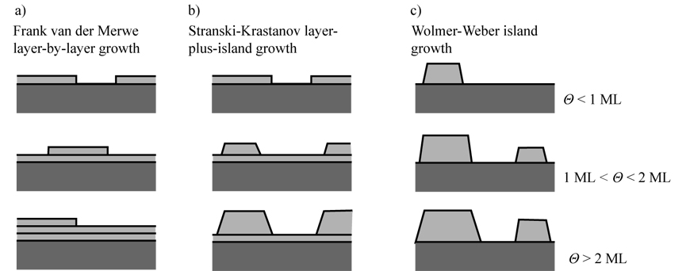
Material Growth Modes
Some materials rather clump together.
Others form flat layers. Some in between.
~ depends on whether the atoms would rather bond to the substrate or itself
Notes:
You can roughly think about it as depending on whether the atoms would rather bond to the substrate or itself. The real quantity to look into would be the surface energy, but that’s not something we are really going into in this class.

Slide 11
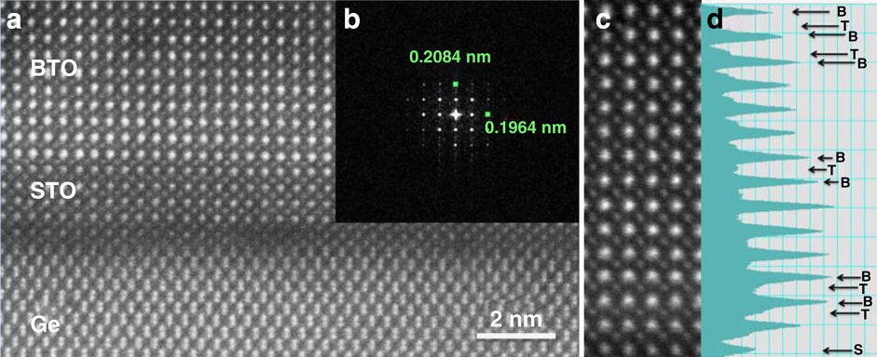
How do you determine sample quality?
Here are some techniques:
Diffraction (secondary phases, symmetry, periodicity, etc.)
Electron microscopy
Atomic force microscopy (surface smoothness)
Notes:
It’s a hard question actually. There are a few obvious ways, but there are other ways that depend on what you want to do with the sample. And what does quality mean? Depends on the purpose.

Slide 12
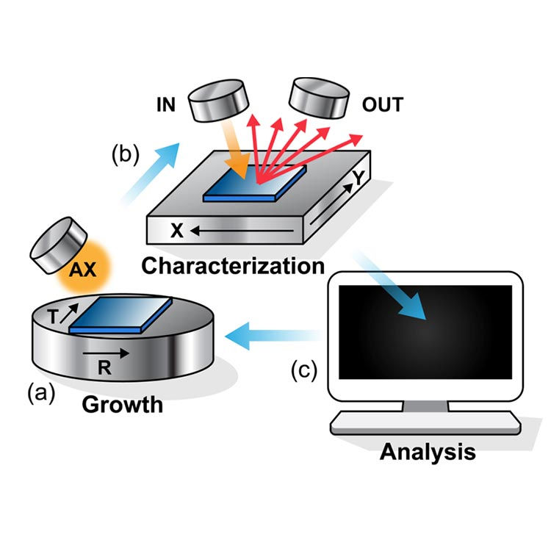
No sample is perfect
Defects reading in Kittel: 585-595

Slide 13
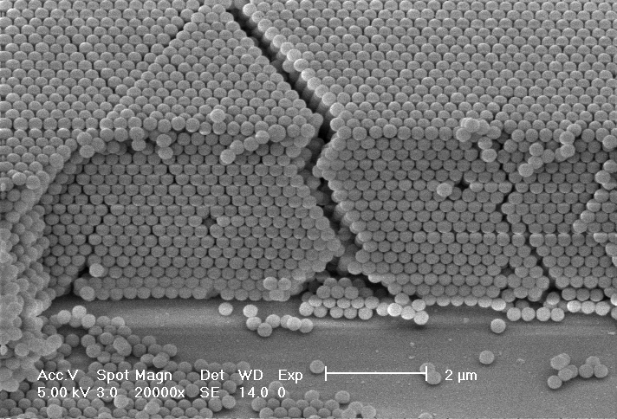
Defects in Solids
Mechanical and electrical properties of solids depend strongly on amount of defects
How would you expect this crack to affect material properties?
Notes:
Actually, these are not pictures of atoms, which is even more obvious if you look at the scale I cut off. These are polystyrene spheres for self-assembled photonic crystals with intentional low-dimensional defects for defect-mode pass-band in stop-band of photonic bandgap. But, they do help might my point. ☺
How would you expect the defects show to affect the properties of the material? The big crack would certainly affect material strength. Also, it would likely be hard to flow valence electrons across that crack.

Slide 14
Defects in Solids
Mechanical and electrical properties of solids depend strongly on amount of defects
Surface/interface reconstruction sometimes treated as defect (topic of next class)
Notes:
Actually, these are not pictures of atoms, which is even more obvious if you look at the scale I cut off. These are polystyrene spheres for self-assembled photonic crystals with intentional low-dimensional defects for defect-mode pass-band in stop-band of photonic bandgap. But, they do help make my point. ☺
How would you expect the defects show to affect the properties of the material? The big crack would certainly affect material strength. Also, it would likely be hard to flow valence electrons across that crack.

Slide 15
Types of Defects
Vacancy
(atoms don’t always get closer, why?)
Ideal Crystal
Notes:
Self interstitial cause such a distortion to the lattice, that they rarely form. (high energy)
When might a line defect be favorable? When growing a material on another.

Slide 16
Types of Defects
Vacancy
(atoms don’t always get closer, why?)
Substitutional
Ideal Crystal
Impurities of different atoms
Notes:
Self interstitial cause such a distortion to the lattice, that they rarely form. (high energy)
When might a line defect be favorable? When growing a material on another.

Slide 17
Types of Defects
Vacancy
(atoms don’t always get closer, why?)
  Interstitial just means between the atoms. You can have a self-interstitial defect too.
Interstitial
Substitutional
Ideal Crystal
Impurities of different atoms
Notes:
Self interstitial cause such a distortion to the lattice, that they rarely form. (high energy)
When might a line defect be favorable? When growing a material on another.

Slide 18
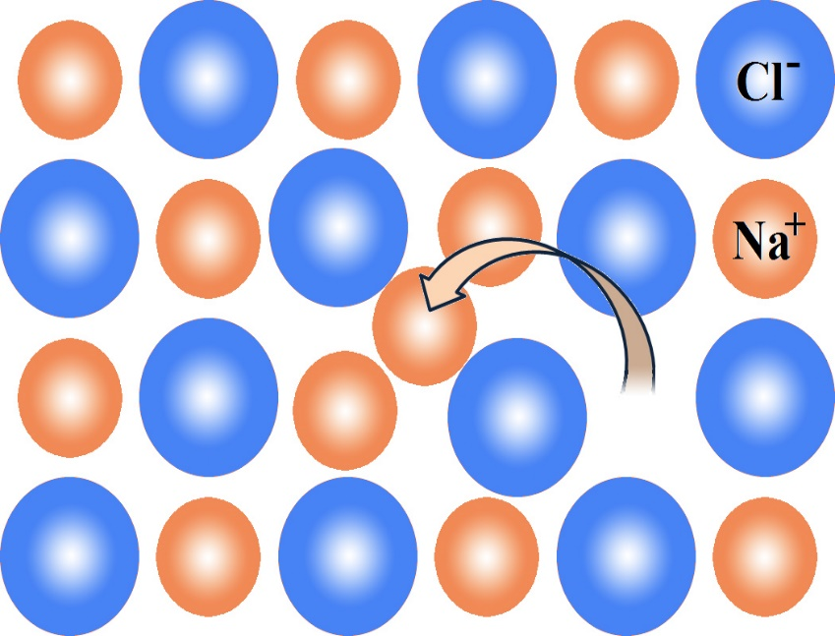
Types of Defects
Vacancy
(atoms don’t always get closer, why?)
  Interstitial just means between the atoms. You can have a self-interstitial defect too.
Interstitial
Self-interstitial + nearby vacancy called Frenkel defect
Substitutional
Ideal Crystal
Impurities of different atoms
Notes:
Self interstitial cause such a distortion to the lattice, that they rarely form. (high energy)
When might a line defect be favorable? When growing a material on another.

Slide 19
Types of Defects
Vacancy
(atoms don’t always get closer, why?)
  These are all point defects (aka Schottky defects)
  which consist of only one or a few atoms, does not necessarily involve foreign atoms
  Interstitial just means between the atoms. You can have a self-interstitial defect too.
Interstitial
Self-interstitial + nearby vacancy called Frenkel defect
Substitutional
Ideal Crystal
Impurities of different atoms
Notes:
Self interstitial cause such a distortion to the lattice, that they rarely form. (high energy)
When might a line defect be favorable? When growing a material on another.

Slide 20
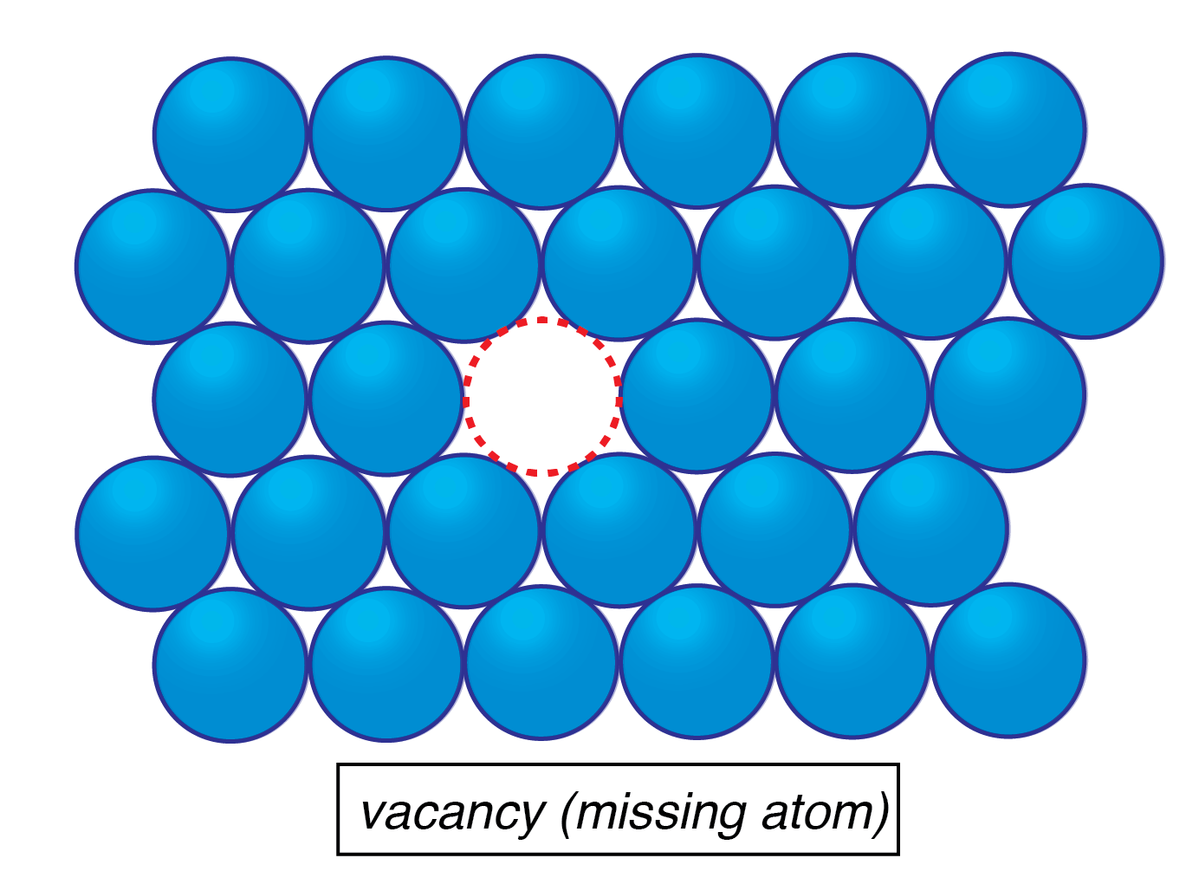
Modeling Vacancies
What information do you think might be important to model bonds?
Notes:
Bonds are stronger in ionic and covalent materials so vacancy energy should be higher. Thus ionic should have less vacancies than metal.
Also, vacancies in ionic materials tend to come in pairs to keep material charge neutral. If not, will likely get other stuff coming into system to balance the charge.
Treat ionic defects similar to Frenkel defects.
Irradiating and deformation can cause a lot of Frenkel defects

Slide 21
Modeling Vacancies
  Vacancies modeled by considering the energy E_{v} required to break the bonds between an atom inside the crystal and its nearest neighbors
Notes:
Bonds are stronger in ionic and covalent materials so vacancy energy should be higher. Thus ionic should have less vacancies than metal.
Also, vacancies in ionic materials tend to come in pairs to keep material charge neutral. If not, will likely get other stuff coming into system to balance the charge.
Treat ionic defects similar to Frenkel defects.
Irradiating and deformation can cause a lot of Frenkel defects

Slide 22
Modeling Vacancies
  Vacancies modeled by considering the energy E_{v} required to break the bonds between an atom inside the crystal and its nearest neighbors
  Discussion: Compare the expected number of vacancies in an ionic material to a metal.
Notes:
Bonds are stronger in ionic and covalent materials so vacancy energy should be higher. Thus ionic should have less vacancies than metal.
Also, vacancies in ionic materials tend to come in pairs to keep material charge neutral. If not, will likely get other stuff coming into system to balance the charge.
Treat ionic defects similar to Frenkel defects.
Irradiating and deformation can cause a lot of Frenkel defects

Slide 23
Modeling Vacancies
  Vacancies modeled by considering the energy E_{v} required to break the bonds between an atom inside the crystal and its nearest neighbors
  Discussion: Compare the expected number of vacancies in an ionic material to a metal.
  Vacancies in ionic materials tend to come in pairs (neutrality)
Notes:
Bonds are stronger in ionic and covalent materials so vacancy energy should be higher. Thus ionic should have less vacancies than metal.
Also, vacancies in ionic materials tend to come in pairs to keep material charge neutral. If not, will likely get other stuff coming into system to balance the charge.
Treat ionic defects similar to Frenkel defects.
Irradiating and deformation can cause a lot of Frenkel defects

Slide 24
Modeling Vacancies
  Vacancies modeled by considering the energy E_{v} required to break the bonds between an atom inside the crystal and its nearest neighbors
  Discussion: Compare the expected number of vacancies in an ionic material to a metal.
  Vacancies in ionic materials tend to come in pairs (neutrality)
  Number of vacancies n = N exp (-E_{v}/k_{B}T) where N= number of lattice sites, k_{B} is Boltzmann’s constant
Notes:
Bonds are stronger in ionic and covalent materials so vacancy energy should be higher. Thus ionic should have less vacancies than metal.
Also, vacancies in ionic materials tend to come in pairs to keep material charge neutral. If not, will likely get other stuff coming into system to balance the charge.
Treat ionic defects similar to Frenkel defects.
Irradiating and deformation can cause a lot of Frenkel defects

Slide 25
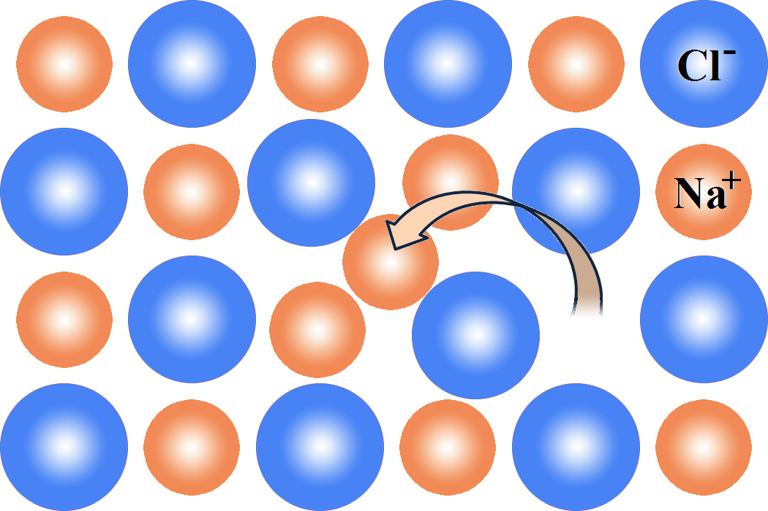
Modeling Vacancies
  Vacancies modeled by considering the energy E_{v} required to break the bonds between an atom inside the crystal and its nearest neighbors
  Discussion: Compare the expected number of vacancies in an ionic material to a metal.
  Vacancies in ionic materials tend to come in pairs (neutrality)
  Number of vacancies n = N exp (-E_{v}/k_{B}T) where N= number of lattice sites, k_{B} is Boltzmann’s constant
  Frenkel changes factor of ½ and N to √NN’, interstitial sites N’
Notes:
Bonds are stronger in ionic and covalent materials so vacancy energy should be higher. Thus ionic should have less vacancies than metal.
Also, vacancies in ionic materials tend to come in pairs to keep material charge neutral. If not, will likely get other stuff coming into system to balance the charge.
Treat ionic defects similar to Frenkel defects.
Irradiating and deformation can cause a lot of Frenkel defects

Slide 26
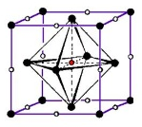
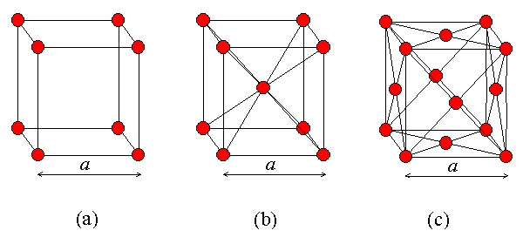
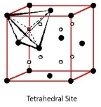
Where would you expect an interstitial to go in a lattice with a one atom basis?
FCC
YouTube videos to further explain:
https://www.youtube.com/watch?v=4AW9PFWaMcQ
https://www.youtube.com/watch?v=ZuWMA8JvgjM
Notes:
Sc first, in center
Fcc next, also in center but edges also likely
Bcc, face center
Videos after discussing this:
Maybe cut first video before cell projection (not necessary, maybe confusing for some, but it does relate back to early crystal structure stuff)
I’m debating on whether I like the second video better, but it takes more time. Motivates a little more

Slide 27
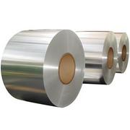
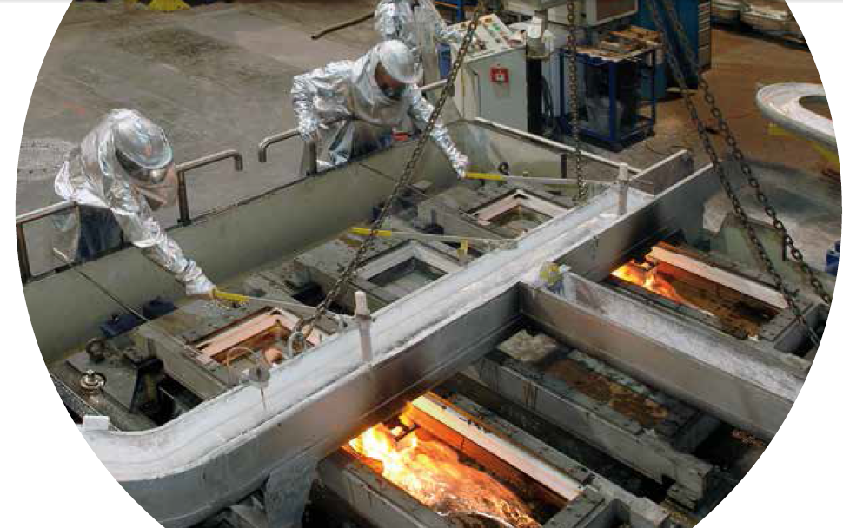
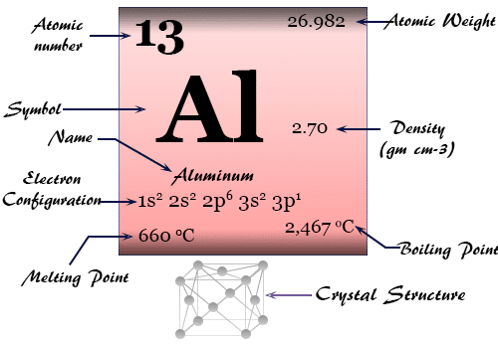
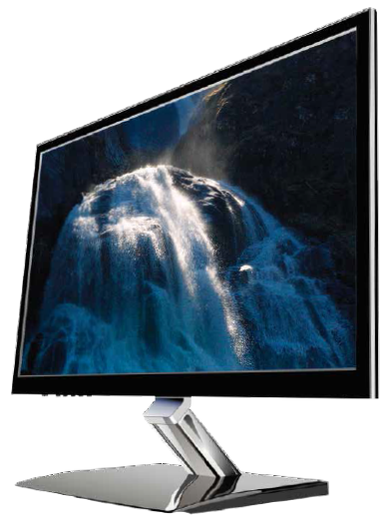
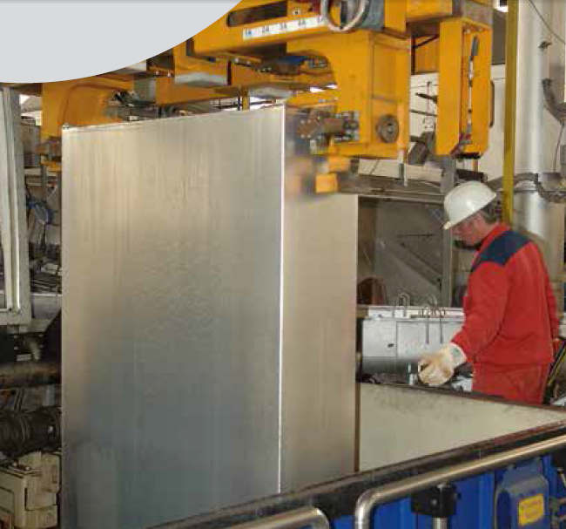
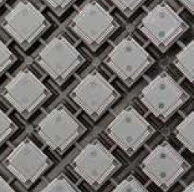
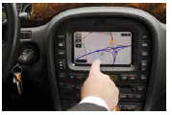
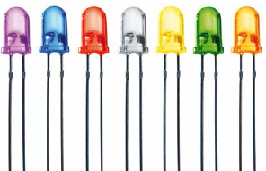
High Purity Aluminum
has a variety of applications
If you get a sheet of aluminum (1 ft x 1 ft by .5 inch), what will be the total number of aluminum atoms at 20°C and approximate the number of vacancies expected at 160, 200, 300 and 900K if the energy to create a vacancy is 0.75 eV?
Notes:
Melting point of aluminum if 933 K.
If you have a one atom basis, the number of lattice sites is the same as the number of atoms
Yes the volume of the material will increase as heated.

Slide 28
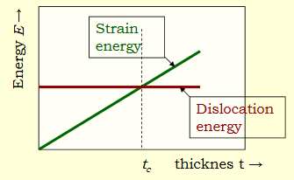
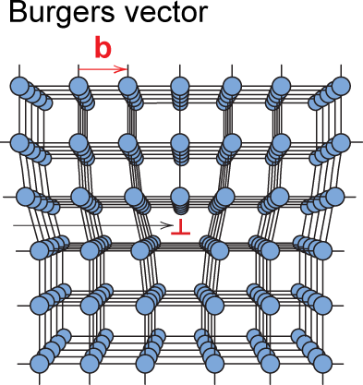
Dislocations
Two-dimensional defect
Dislocation is a common one
Results from local elastic stress
is a line defect
Notes:
Start at M and count a 3x4 box around

Slide 29
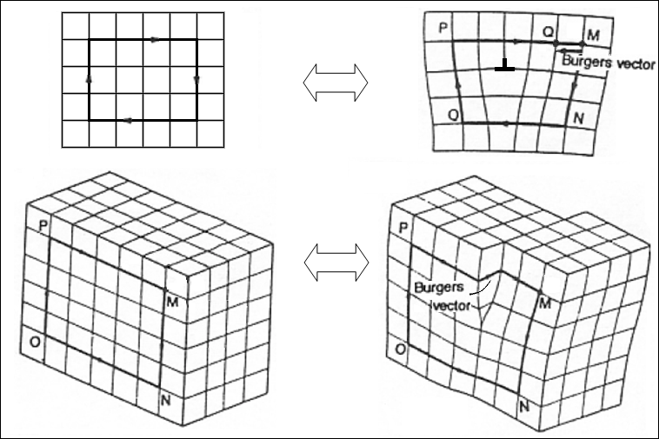
Dislocations
Two-dimensional defect
Dislocation is a common one
Results from local elastic stress
Described by Burgers vector
  Constructed via closed loop around dislocation core
is a line defect
Notes:
Start at M and count a 3x4 box around

Slide 30
Dislocations
Two-dimensional defect
Dislocation is a common one
Results from local elastic stress
Described by Burgers vector
  Constructed via closed loop around dislocation core
is a line defect
3
Notes:
Start at M and count a 3x4 box around

Slide 31
Dislocations
Two-dimensional defect
Dislocation is a common one
Results from local elastic stress
Described by Burgers vector
  Constructed via closed loop around dislocation core
is a line defect
3
4
Notes:
Start at M and count a 3x4 box around

Slide 32
Dislocations
Two-dimensional defect
Dislocation is a common one
Results from local elastic stress
Described by Burgers vector
  Constructed via closed loop around dislocation core
is a line defect
3
3
4
Notes:
Start at M and count a 3x4 box around

Slide 33
Dislocations
Two-dimensional defect
Dislocation is a common one
Results from local elastic stress
Described by Burgers vector
  Constructed via closed loop around dislocation core
is a line defect
4
3
3
4
Notes:
Start at M and count a 3x4 box around

Slide 34
Dislocations
Two-dimensional defect
Dislocation is a common one
Results from local elastic stress
Described by Burgers vector
  Constructed via closed loop around dislocation core
  Edge dislocation: Burgers vector perpendicular to dislocation line
is a line defect
4
3
3
4
Notes:
Start at M and count a 3x4 box around

Slide 35
Dislocations
Two-dimensional defect
Dislocation is a common one
Results from local elastic stress
Described by Burgers vector
  Constructed via closed loop around dislocation core
  Edge dislocation: Burgers vector perpendicular to dislocation line
  Screw dislocation: Burgers vector parallel to dislocation line
is a line defect
4
3
3
4
Notes:
Start at M and count a 3x4 box around

Slide 36
Dislocations
Two-dimensional defect
Dislocation is a common one
Results from local elastic stress
Described by Burgers vector
  Constructed via closed loop around dislocation core
  Edge dislocation: Burgers vector perpendicular to dislocation line
  Screw dislocation: Burgers vector parallel to dislocation line
  Real dislocations are often a mix
is a line defect
4
3
3
4
Screw dislocation
Notes:
Start at M and count a 3x4 box around

Slide 37

How would you make a stack of sandwiches look like a screw dislocation?

Slide 38
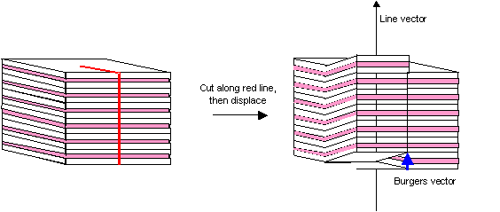
How would you make a stack of sandwiches look like a screw dislocation?

Slide 39
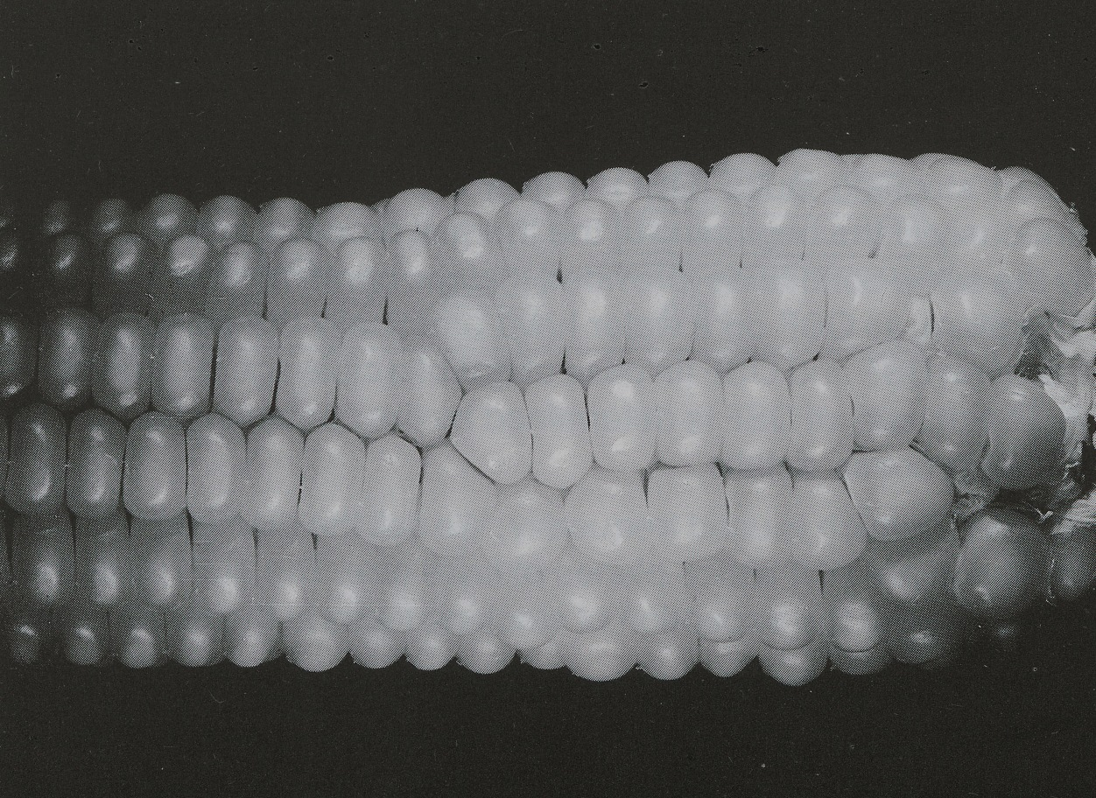
What kind of dislocation is this?
Notes:
Corn = edge dislocation

Slide 40
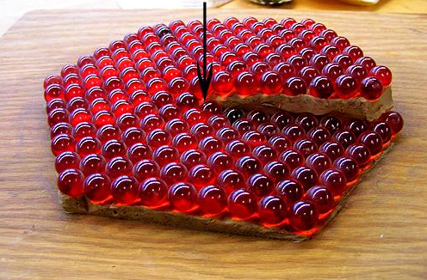
What kind of dislocation is this?
Notes:
Corn = edge dislocation

Slide 41
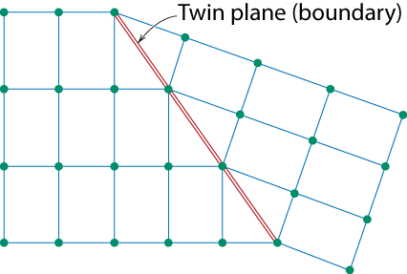
Planar Defects
One case is a twin boundary (plane)
  Essentially a reflection of atom positions across the twinning plane.
Stacking faults
  For FCC metals an error in ABCABC packing sequence
  Ex: ABCABABC
Adapted from Fig. 4.9, Callister 7e.

Slide 42
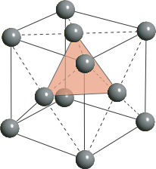
Close packed crystals
A plane
B plane
C plane
A plane
…ABCABCABC… packing
[Face Centered Cubic (FCC)]
…ABABAB… packing
[Hexagonal Close Packing (HCP)]
Notes:
0.74 for both fcc and hcp

Slide 43
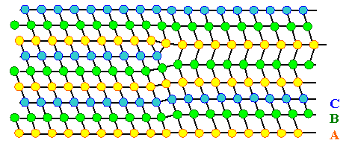
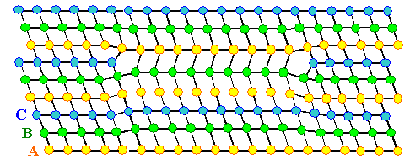
Stacking Faults

Slide 44
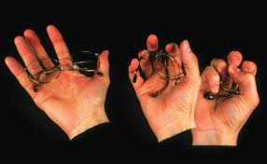
    Defects in Metallic Crystals
      Most metals crystallize in bcc, fcc or hcp structures
      Changing pressure or temp. can interchange these forms for a metal
      Soft and malleable metals usually have fcc structure (copper)
      Harder and more brittle metals usually have the hcp structure (zinc)
        Atoms can slide past each other and then realign into crystal form
        Dislocations (imperfections in lattice) make it easier to bend
        Impurities (imperfections in atom type) allow slippage of layers
        Work Hardening means hammer until impurities are together
        Heat: can soften by dispersing impurities or harden if control cooling
Notes:
Mention shape memory alloys

Slide 45
Defect Summary
Point, Line, Planar and Volumetric defects exist in solids.
The number and type of defects can be varied and controlled
  T controls vacancy concentration
  amount of plastic deformation controls # of dislocations
Defects affect material properties (e.g., grain boundaries control crystal slip, conductivity)
Defects may be desirable or undesirable
  e.g., dislocations may be good or bad, depending on whether plastic deformation is desirable or not.
Notes:
Got to this slide in 50 minute lecture.

